Slide 1
2D game physics
Course : 2D Game Programming
Effective Period : September 2018

Slide 2
These slides have been adapted from: Pereira, V. (2014). Learning Unity 2D Game Development by Example, Packt Publishing, Inc. San Francisco. ISBN: 9781783559046 Chapter 9
Acknowledgement

Slide 3
Learning Objectives
LO 1 : Create 2D game for PC platform
LO 2 : Apply best practices of 2D game development
LO 3 : Design 2D game for PC platform

Slide 4
The basics of physics
In order to make our games more realistic and therefore simulate real life, we make use of physics. However, to make use of it within our games, we first need to understand the basics of physics.
Just as a game needs rules in order to function, so too does the world around us. The natural world is governed by rules. The science that explains how the world is governed by these rules using measurable data is known as natural science. Physics is a branch of natural science that explains matter and the motion of matter through time and space.

Slide 5
Physics found in the real world
Physics covers an extremely vast range of concepts, and as such we will only look at the relevant basic quantities that provide the foundations of physics. The following are the basic quantities:
Matter: Just as matter in the world is everything around us that is made up of atoms and molecules, in relation to games, the objects in our game are the matter in the game world.
Time: We use time to set intervals on an object's movement or when we want events to be triggered, for example, when spawning an object.
Length: This is a quantitative measurement of distance.
Vectors: This is a quantity that has both direction and magnitude. A vector has x, y, and z coordinate values. We have been using vectors to position and move our objects.
Space: This is an unoccupied area around us, and in the case of the game, our scene would be space.

Slide 6
Physics found in the real world
Physics covers an extremely vast range of concepts, and as such we will only look at the relevant basic quantities that provide the foundations of physics. The following are the basic quantities:
Mass: This is the amount of matter that an object is made up of.
Velocity: This is the speed that something is moving at in a certain direction.
Acceleration: This is the rate at which velocity changes at any given time.
Force: This is the energy that results in movement.
Rigid body: This is a solid body whereby deformation is neglected, so no matter how much force acts upon a rigid body, its form remains constantly rigid.

Slide 7
Physics found in the real world
Physics covers an extremely vast range of concepts, and as such we will only look at the relevant basic quantities that provide the foundations of physics. The following are the basic quantities:
Drag: This is the air or fluid resistance acting to slow down the velocity of an object.
Angular drag: This is the same as drag, but it refers to the rotation of the resistance acting to slow down the rotational speed of an object.
Collision: This occurs when multiple objects/bodies exert forces on each other for a certain amount of time.
Inertia: This is the resistance of an object to move due to its mass. It is the desire for an object to stay moving at its current velocity, for instance, if moving to the left-hand side, keep moving to the left-hand side, or if at rest, keep staying at rest.

Slide 8
Physics found in the real world
Physics covers an extremely vast range of concepts, and as such we will only look at the relevant basic quantities that provide the foundations of physics. The following are the basic quantities:
Momentum: This is the product of the mass and velocity of a moving object/body.
Damping: This is the resistance upon oscillations (to and fro motions like a spring moving). For instance, the higher the damping, the quicker a spring moving up and down will come to a stop, whereas the lower the damping, the longer it will take for a spring moving up and down to come to rest.
Gravity: This is an object/body's force of attraction towards the center of the earth.
Friction: This is the resistance that an object/body faces when moving over another object/body while in contact. .

Slide 9
Physical quantities specific to physics engines
Kinematic: This is the motion of an object/body without taking mass or forces into account.
Static: This is the state of a non-moving object/body.
Interpolate: This creates smoother movement by calculating the key data points between the start and end of the movement.

Slide 10
Physics 2D
Those of us that are already familiar with Unity are aware of the original Physics component. However, this component only works for 3D. There is now a new component specifically for 2D called Physics 2D. The Physics 2D Manager has the global settings for Physics 2D.

Slide 11
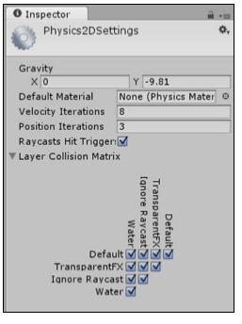
Physics 2D
To access it, we do the following
Go to Edit | Project Settings | Physics 2D. We would see the Physics 2D Manager
Image source:
Pereira, V. (2014). Learning Unity 2D Game Development by Example. Packt Publishing, Inc. San Francisco.

Slide 12
Physics 2D
The Physics 2D Manager settings are as follows
Gravity: We can set the global gravity that will affect all objects in our game. X is for horizontal gravity along the x axis and Y is for vertical gravity along the y axis.
Default Material: This is an assigned Physics 2D Material. By default, None is assigned.
Velocity Iterations: This is the number of iterations by the physics engine to calculate the changes in velocity of an object/body. The higher this value, the more accurate it is, but it is more expensive from the CPU's standpoint.
Position Iterations: This is the number of iterations by the physics engine to calculate the changes in position of an object/body. The higher this value, the more accurate it is, but it is more expensive from the CPU's standpoint.
Raycast Hit Trigger: If this option is ticked and therefore enabled, then whenever a collider is set as a trigger, a hit will be returned as true when it is hit by a raycast. If disabled, it will return false.
Layer Collision Matrix: This sets which layers can interact with each other. By default, they are all enabled, so objects on any layer can collide with objects on any other layer.

Slide 13
Physics 2D
The Physics 2D Manager settings are as follows
Gravity: We can set the global gravity that will affect all objects in our game. X is for horizontal gravity along the x axis and Y is for vertical gravity along the y axis.
Default Material: This is an assigned Physics 2D Material. By default, None is assigned.
Velocity Iterations: This is the number of iterations by the physics engine to calculate the changes in velocity of an object/body. The higher this value, the more accurate it is, but it is more expensive from the CPU's standpoint.
Position Iterations: This is the number of iterations by the physics engine to calculate the changes in position of an object/body. The higher this value, the more accurate it is, but it is more expensive from the CPU's standpoint.
Raycast Hit Trigger: If this option is ticked and therefore enabled, then whenever a collider is set as a trigger, a hit will be returned as true when it is hit by a raycast. If disabled, it will return false.

Slide 14
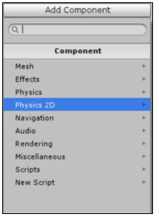
What is Box2D?
The Physics 2D component makes use of Box2D. Box2D is a free, open source physics engine specifically designed for 2D by Erin Catto. It has been used in many successful 2D games, and is most widely known in the hit game Angry Birds.
Image source:
Pereira, V. (2014). Learning Unity 2D Game Development by Example. Packt Publishing, Inc. San Francisco.

Slide 15
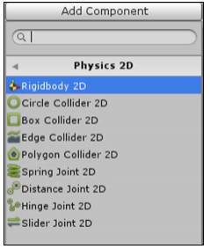
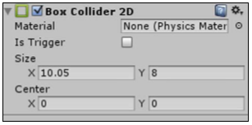
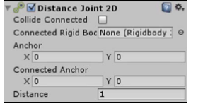
What is Box2D?
There are three collective types of Physics 2D components available:
Rigidbodies
Colliders
Joints
Image source:
Pereira, V. (2014). Learning Unity 2D Game Development by Example. Packt Publishing, Inc. San Francisco.

Slide 16
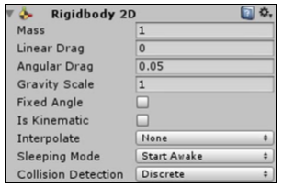
Steps to create bodies
The Rigidbody 2D component sets an object/body to be affected by physics. To create a Rigidbody, we can fo to Add Component | Physics 2D | Rigidbody 2D
It will shows
Image source:
Pereira, V. (2014). Learning Unity 2D Game Development by Example. Packt Publishing, Inc. San Francisco.

Slide 17
Rigidbodies
We will go through all the Rigidbody settings. These are described as follows
Mass: This refers to the mass of the object/body
Linear Drag: This drag affects the movement in position
Angular Drag: This drag affects the rotation of movement
Gravity Scale: This is the amount of gravity that affects the object/body locally
Fixed Angle: If this is enabled, then the Rigidbody is able to rotate when it's affected by a force
Is Kinematic: This sets whether or not the Rigidbody is kinematic for instances where we want to manually animate the rigid body's position
Interpolate: The interpolation settings between the physics engine's updates (when the physics calculations are updated)

Slide 18
Rigid Bodies
Collision Detection: This consists of settings to detect collisions between the Rigidbody and other objects/bodies. The following are the options under this
Discrete: A collision is detected if the object's collider collides with another collider during a physics update.
Continuous: Each physics update will perform extra work to make sure collisions are not missed. This is an important setting to use if we have very fast-moving rigid bodies. Fast-moving rigid bodies can miss colliding with each other if we use only the Discrete mode, but will not miss each other if we use the Continuous mode.

Slide 19
Rigidbodies
The following are the options under Interpolate
None: By default, Interpolate is set to none as it is only required when the movement of the Rigidbody is not smooth
Interpolate: The object's movement is smoothed by taking into account the object's position from the previous frames
Extrapolate: The object's movement is smoothed by estimating the object's position in the next frame

Slide 20
Rigid Bodies
Sleeping Mode: These settings are used to save processor time when the Rigidbody sleeps (rests).
Never Sleep: This option is used to ensure the object never sleeps.
Start Awake: When this option is used, the object is initially set to be awake and can then be set to sleep.
Start Asleep: When this option is used, the object is initially set to sleep; however, it can be awoken by collisions.

Slide 21
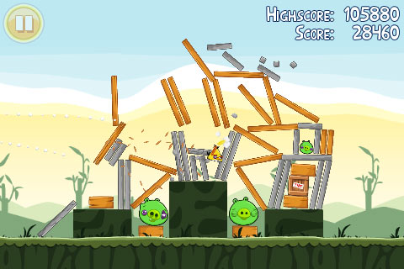
Assignment
Design a game that uses a game physics

Slide 22
Summary
In this meeting, you learned about the basics of physics and how to use physics in our own game using Unity's new Physics 2D, including the Box2D physics with bodies to simulate the real world.

Slide 23
Discussion
What game that show a great usage of physics?
What are the possibilities of using physics in game?

Slide 24
References
Calabrese, D. (2014). Unity 2D Game Development. Packt Publishing, Inc. San Francisco. ISBN: 9781783559046
Freeman, J. (2015). Unity’s New 2D Workflow
Vidyasagar. (2014. Unity and C#: Game Loop.CodeProject
Pereira, V. (2014). Learning Unity 2D Game Development by Example. Packt Publishing, Inc. San Francisco. ISBN: 9781783559046

